Slide 1
Interactive Lesson Advanced Programming: iOS on SpriteKit
Alejandro Ferrero

Slide 2
What is SpriteKit?
It is a graphics rendering and animation infrastructure that you can use to animate arbitrary textured images, otherwise known as sprites
Provides powerful features
Determines contents and how they change
It takes care of frame rendering
Suited for games and apps that require flexibility in how animations are handled

Slide 3
Real App Examples
Both games were entirely developed using uniquely SpriteKit features
2-D Graphics
SpriteKit Elements
SKNode
SKView
SKScene
SKTransition
SKSpriteNode
Flappy Bird
Color Switch

Slide 4
Key Elements
SKNode – Fundamental building block of most SpritKit content
SKView – An object that displays SpriteKit content. This content is provided by an SKScene object
SKScene – The root node for all Sprite Kit objects displayed in a view
SKTransition – An object used to perform an animated transition between a SKScene object already presented by an SKView object and a new incoming scene
SKSpriteNode - A node that draws a rectangular texture, image or color

Slide 5
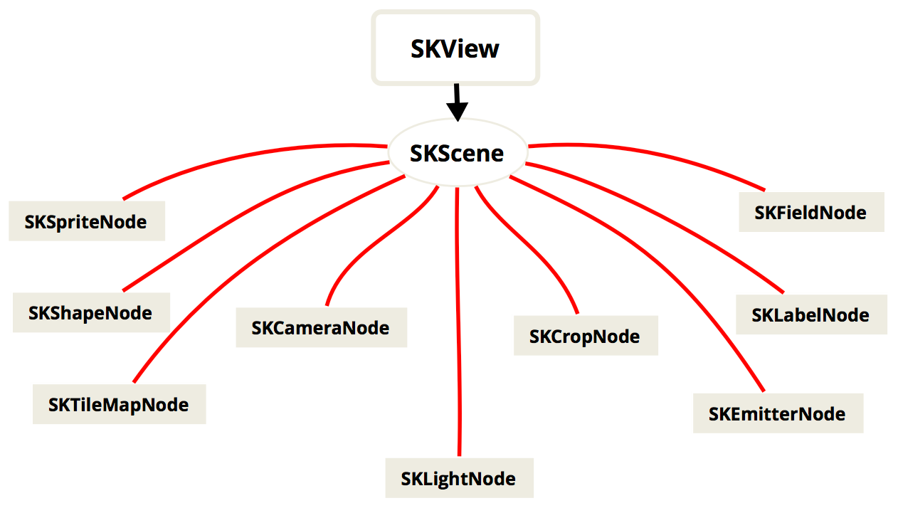
SKNode Tree Diagram

Slide 6
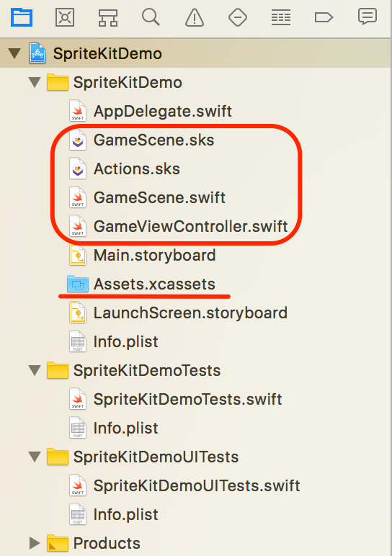
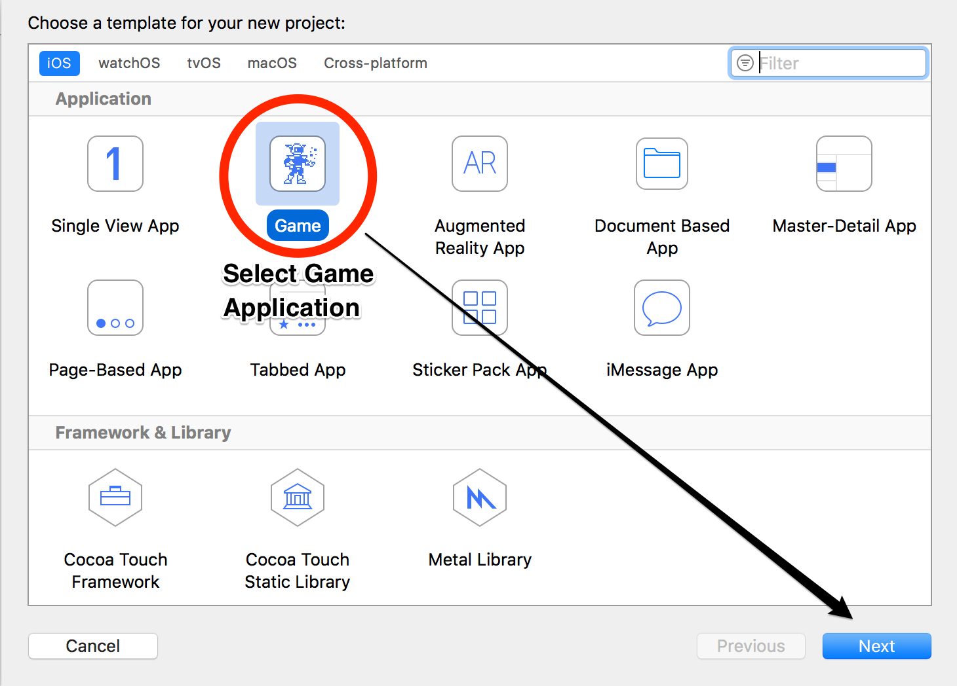
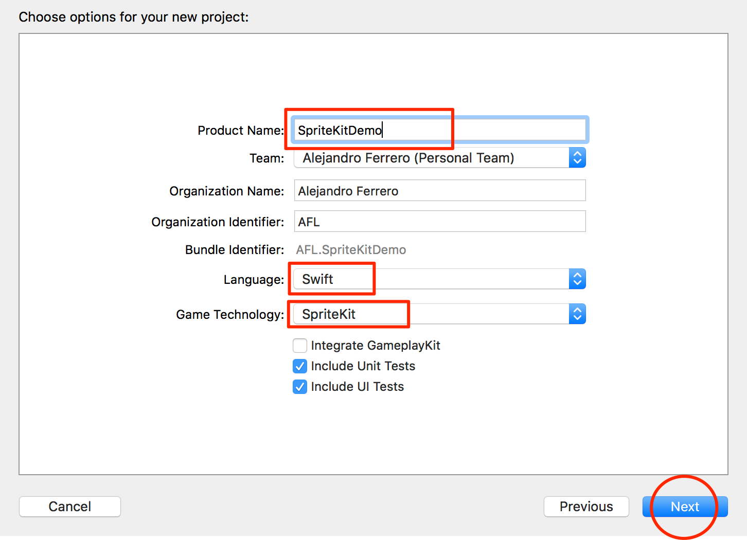
Create a Project including SpriteKit

Slide 7
Visual vs Programmatic Setup
When creating SKNodes visually we take a more intuitive and visual approach
GameScene.sks
Actions.sks
When creating SKNodes programatically we take a more complex and precise approach
GameScene.swift

Slide 8
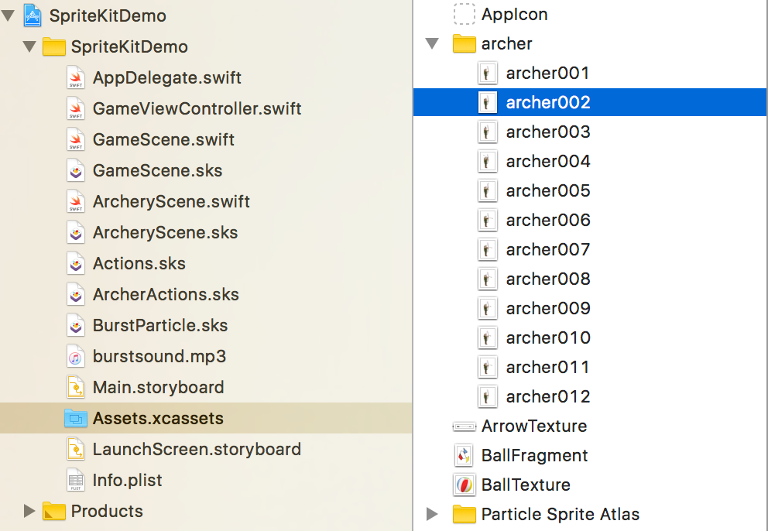
Assets.xcassets Group
Whether you are taking a visual or programmatically approach this Group is essential
Keeps all our project images organized
Images are easily accessible
These images allow for the creation of special SKNodes
SKSpriteNode

Slide 9
Essential Skills
Create Nodes
Manage Actions
Handle Transitions
Include Sound Effects
Clear understanding of PhysicsWorld (Gravity, Collisions)
Node Intersection

Slide 10
Hands-on Demo

Slide 11
Resources
GitHub Repository with Full SpriteKit App
https://github.com/alefl10/SpriteKitDemo
Book, iOS 10 App Development
Beginners Tutorial
https://www.raywenderlich.com/145318/spritekit-swift-3-tutorial-beginners
Advanced Tutorials
https://www.raywenderlich.com/123393/how-to-create-a-breakout-game-with-sprite-kit-and-swift
https://www.raywenderlich.com/82022/make-game-like-cut-rope-using-spritekit-swift
https://www.youtube.com/playlist?list=PL5ulv6GiGpwxjccHR55QYe5mQDLx808er

